Slide 1
Identify abnormal driving behavior using spatio-temporal analysis
CSE 523 Machine Learning
Group - 11

Slide 2
Contents:
Team Members
Problem Statement
Approaches
Dataset
Results
Future Work
References

Slide 3
Team Members
Enrollment Number | Name
AU2140043 | Bhavya Khakhar
AU2140154 | Harsh Loriya
AU2140170 | Krishna Patel
AU2140187 | Priyam Shah

Slide 4
Problem Statement
Identify abnormal driving behavior using spatio-temporal analysis.
The idea of the project is to predict the normal/abnormal driving behavior using different parameters.
Binary classification.

Slide 5
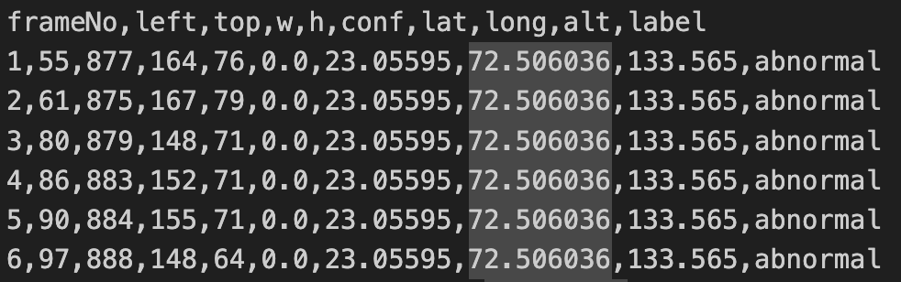
Dataset

Slide 6
Approach
Data Pre-Processing
Feature Extraction Using Ant-Colony Model
Classification Using Logistic Regression

Slide 7
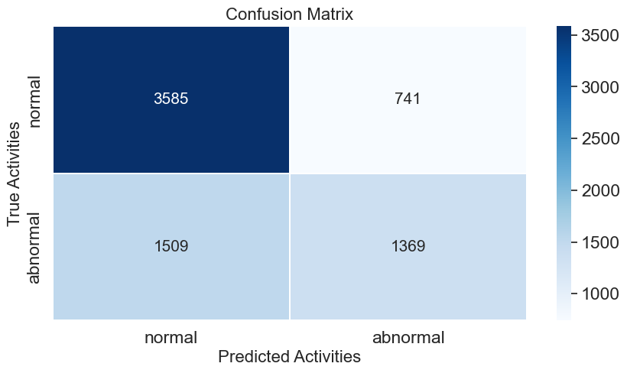
Results(1/2)
T.P
F.P
F.N
F.P
Confusion matrix of Ant colony as feature selection algo and logistic regression for classification algo

Slide 8
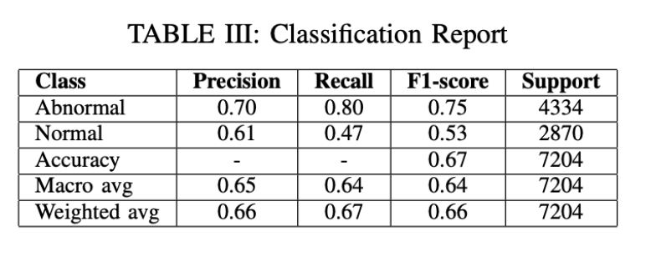
Results(2/2)
It is a classification report of ant colony and logistic regression combine approach.
Precision = TP / TP+FP (tot pre posi)
Recall(Sensitivity) = TP / TP+FN (obs in current class
Accuracy = TP+TN / Total obv
F1 score = 2* (Precision . Recall)
—--------------------
(Precision + Recall)

Slide 9
Future work
Revise the approach
Apply better combination of algorithms for classification ( Ant colony + random forest)

Slide 10
References
Recognition method of abnormal driving behavior using the bidirectional gated recurrent unit and convolutional neural network. (2022, November 18). Recognition Method of Abnormal Driving Behavior Using the Bidirectional Gated Recurrent Unit and Convolutional Neural Network - ScienceDirect. https://doi.org/10.1016/j.physa.2022.128317
Real-time detection of abnormal driving behavior based on long short-term memory network and regression residuals. (2022, December 14). Real-time Detection of Abnormal Driving Behavior Based on Long Short-term Memory Network and Regression Residuals - ScienceDirect. https://doi.org/10.1016/j.trc.2022.103983
https://www.tandfonline.com/loi/uaai20
LoriyaHarsh. (n.d.-c). ML_2024_11_Titans/Mid_Sem_Report/ML_2024_Project_11_Titans_Mid_Sem_Report.pdf at main · LoriyaHarsh/ML_2024_11_Titans. GitHub. https://github.com/LoriyaHarsh/ML_2024_11_Titans/blob/main/Mid_Sem_Report/ML_2024_Project_11_Titans_Mid_Sem_Report.pdf

Slide 11
Thank You.

